Slide 1




Continuous Delivery For Modules to the PowerShell Gallery
Rob Sewell @sqldbawithbeard https://sqldbawithAbeard.com

Slide 2
WHO AM !?

Slide 3
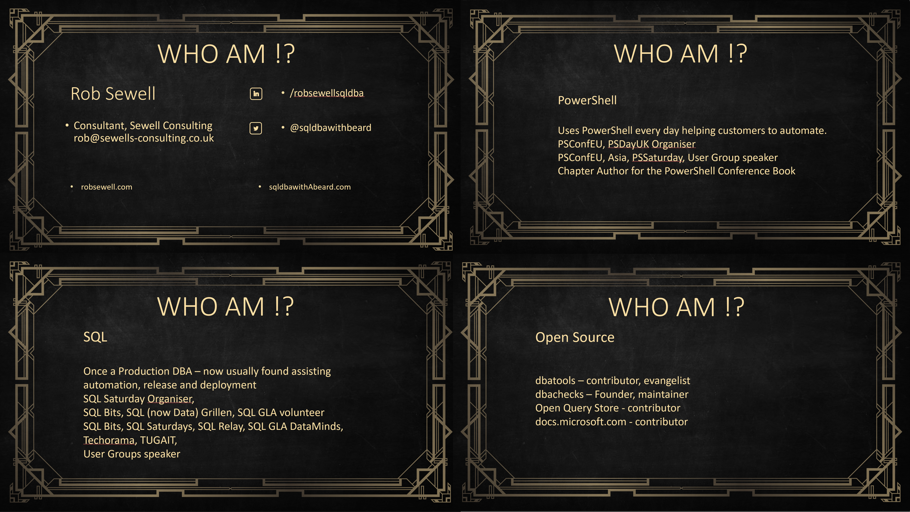

Slide 4
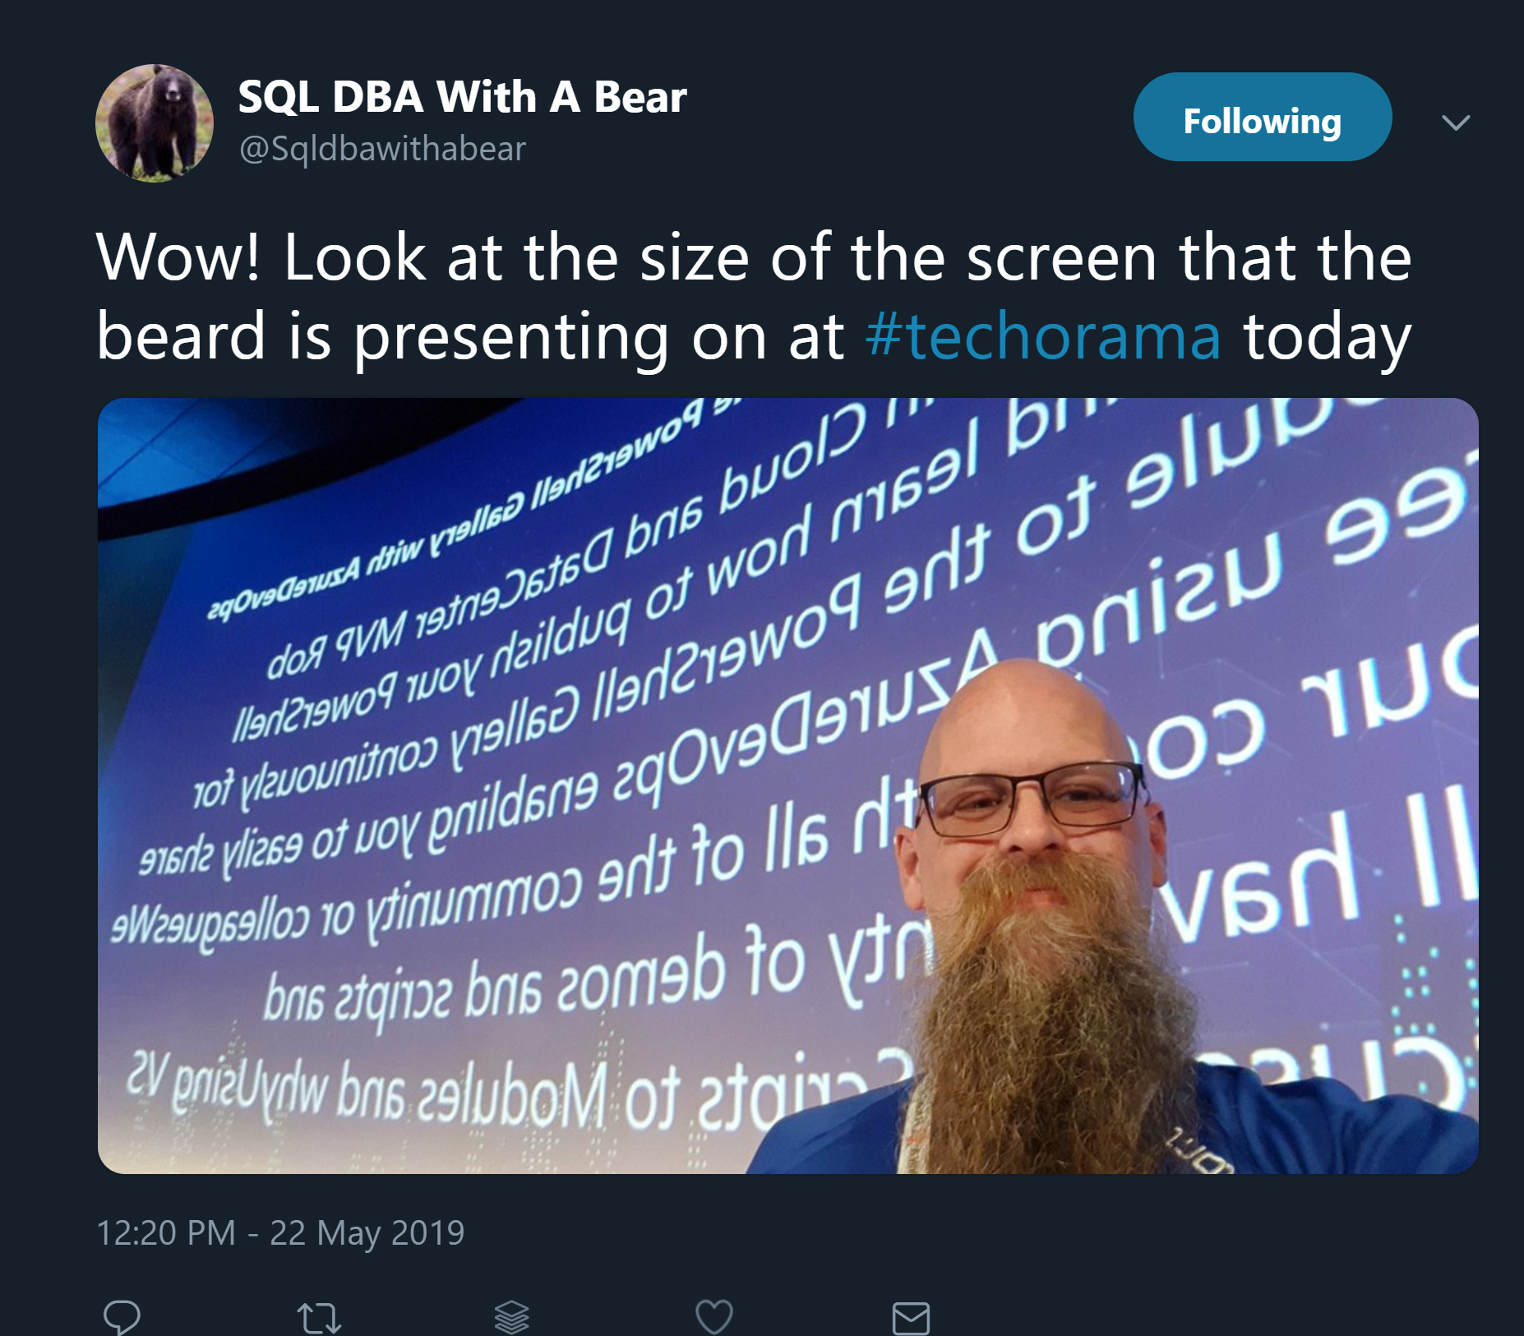

Slide 8


Slide 9
Slides and Code
All My Presentations –
GitHub.com/SQLDBAWithABeard/Presentations

Slide 10
TODAY’s TO DO LIST
GET UP
Drink Coffee
Create Continuous Delivery Process for Delivering Modules to the PowerShell Gallery
Appropriate Liquid

Slide 11
What do we need?
Plaster – Install-Module Plaster
Pester – Install-Module Pester
(Need to take ownership and remove existing Pester folder first)
Or use -SkipPublisherCheck

Slide 12
What do we need?
Plaster – Install-Module Plaster
Pester – Install-Module Pester
GitHub Account
Azure DevOps account
We won‘t have time for much detail!!

Slide 13
Why PowerShell Module?
Ps1 scripts EVERYWHERE!!
Use functionality in other scripts
Share them internally or externally
Modularity
Only export functions user needs

Slide 14
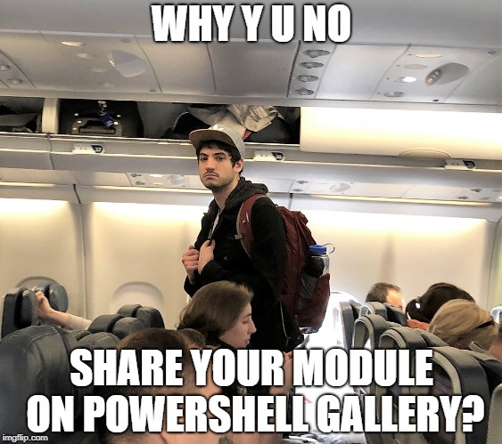
Why PowerShell Gallery?
#SadJoey
#SadJoey

Slide 15
Why PowerShell Gallery?
Public or Private Nuget Repository
Share your Modules
Make them easier to find
Centralise deployment of Modules
https://www.powershellgallery.com

Slide 16
Why Plaster?
Reusability
Parametrisation
Organisational requirements
If you are doing it more than once automate it ☺
https://sqldbawithabeard.com/?s=plaster

Slide 17
Why Pester?
Verify the code is working correctly
Provide design guidance - Support Refactoring
Document the code’s behaviour
If you are doing it more than once automate it ☺
Notes:
Good tests can…
Verify the code is working correctly
Prevent future regressions
Document the code’s behaviour
Provide design guidance
Support refactoring
https://www.devmynd.com/blog/five-factor-testing/

Slide 18
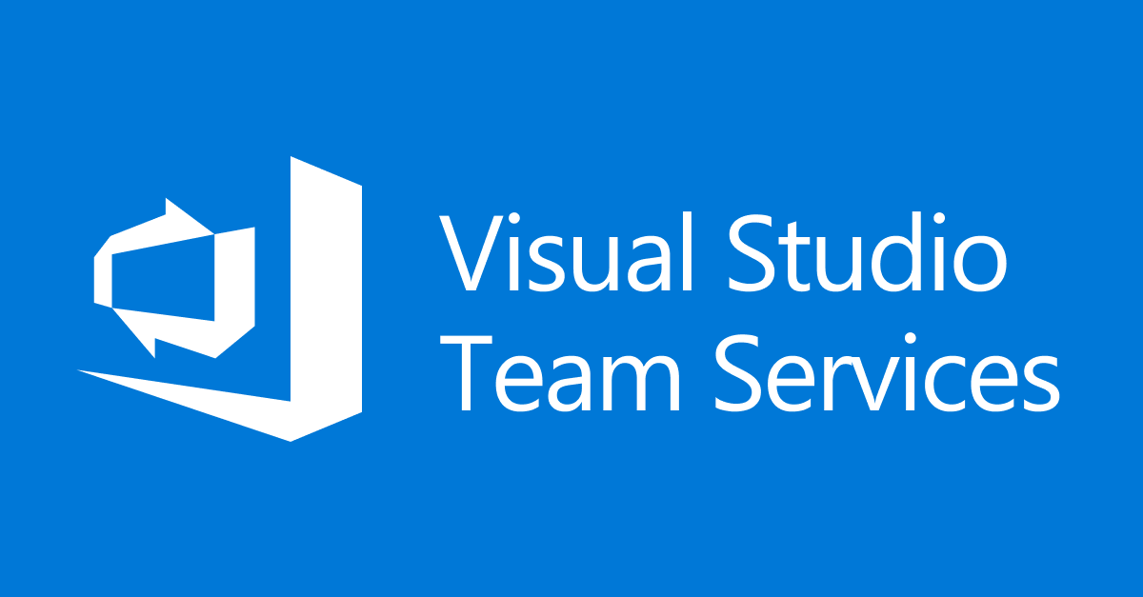

Visual Studio Online
Visual Studio Team Services

Slide 19

Visual Studio Team Services
Azure DevOps

Slide 20
Azure DevOps

Slide 21
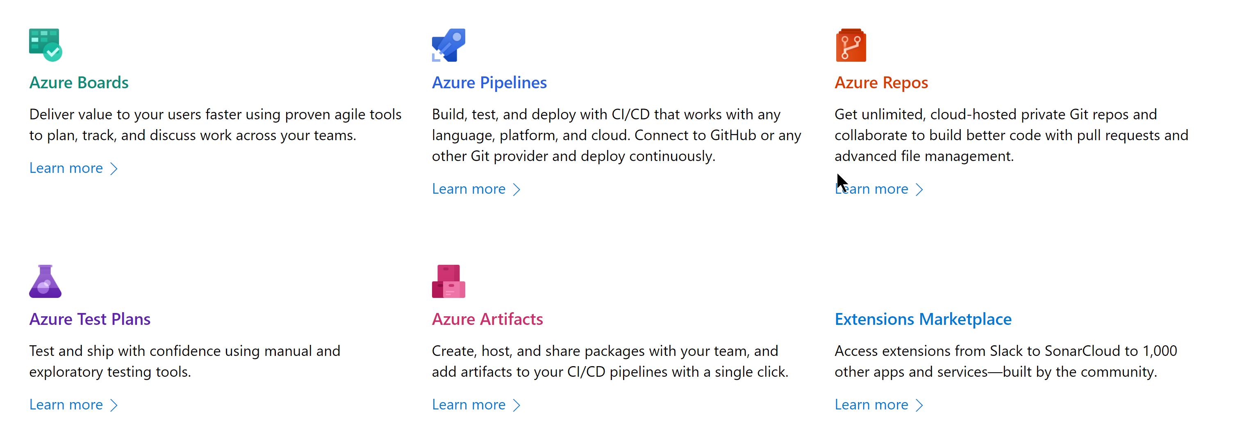
Azure DevOps
https://azure.microsoft.com/en-us/services/devops/

Slide 22

Azure DevOps

Slide 23
Azure DevOps
https://azure.microsoft.com/en-us/services/devops/

Slide 24

Azure DevOps

Slide 25
Azure DevOps
https://azure.microsoft.com/en-us/services/devops/

Slide 26

Azure DevOps

Slide 27
Azure DevOps
https://azure.microsoft.com/en-us/services/devops/

Slide 28

Azure DevOps

Slide 29
Azure DevOps
https://azure.microsoft.com/en-us/services/devops/

Slide 30

Azure DevOps

Slide 31
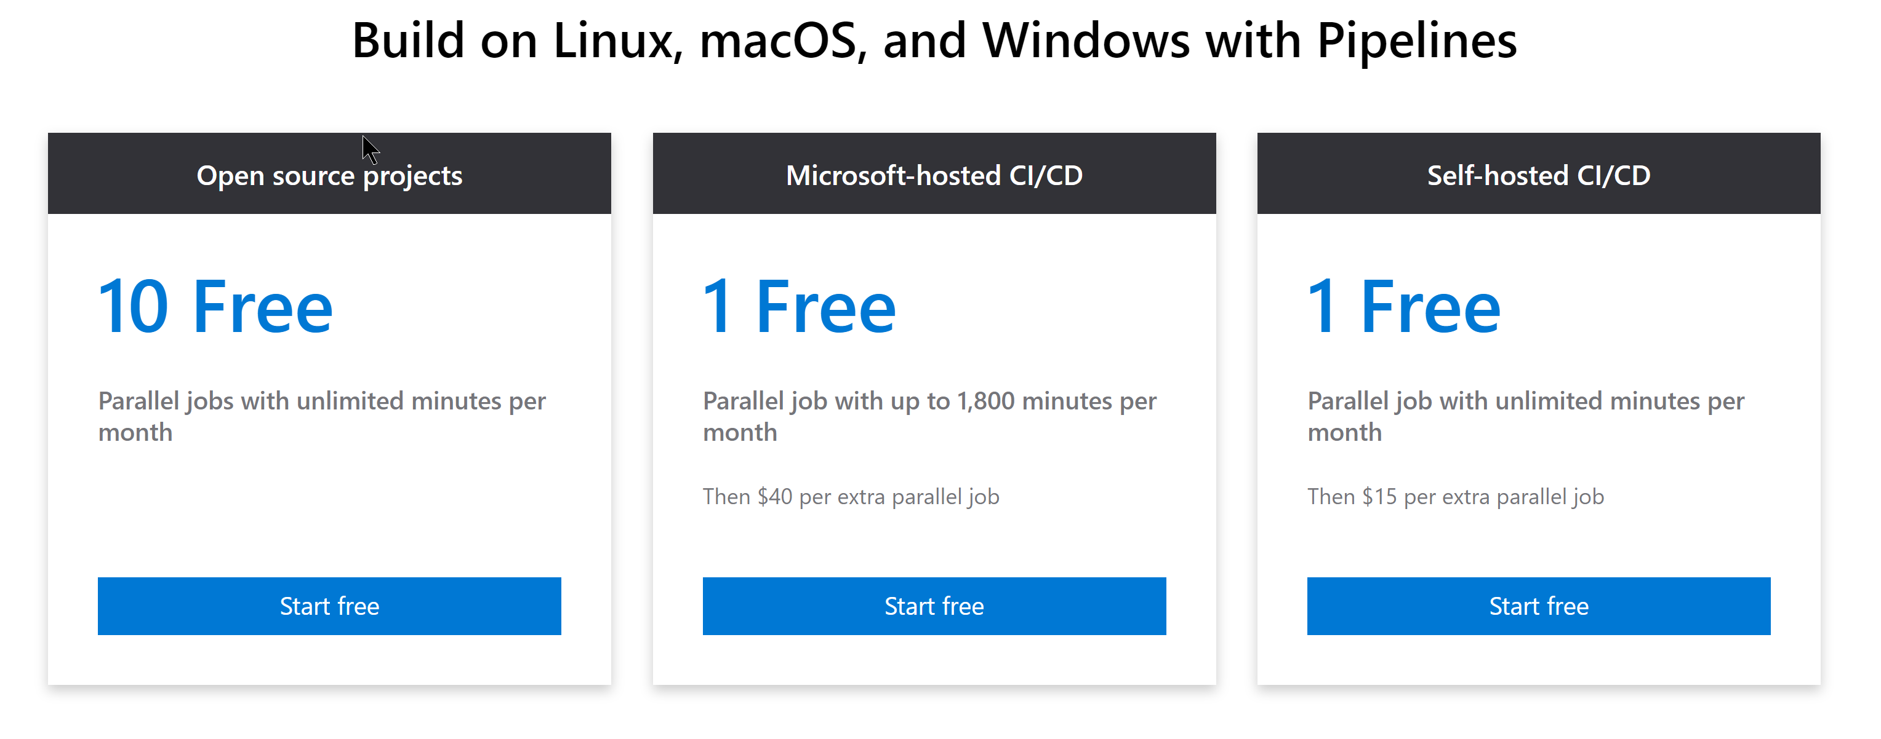
Azure DevOps
https://azure.microsoft.com/en-us/services/devops/

Slide 32
What to do with Azure DevOps?
Unit Test with Build Step on merge to Development
Update Module Number
Sign Code with Certificate using Secure Files
Publish to Gallery
If you are doing it more than once automate it ☺
Notes:
PowerShell Gallery is not for testing!

Slide 33

Hey Beardy – Enough Talk!
Time For A DEMO

Slide 34
Summary
Continuous Delivery of PowerShell Module to the Gallery is easy Plaster can template your module framework
Pester is a Unit Testing Framework for PowerShell
Azure DevOps is free
Have Fun – Create some modules today
Rob Sewell @sqldbawithbeard https://sqldbawithAbeard.com

Slide 35

Questions?
Rob Sewell @sqldbawithbeard sqldbawithAbeard.com
www.linkedin.com/in/robsewellsqldba

